Slide 1
Shell Scripting(Waffle)
Instructor:
Dr. Andrew Sutton
Team:
Rishi Reddy Cheruku

Slide 2
Motivation
Waffle language with sql, bash, modules etc.
Shell scripts are not just commands but programs in their own right.
Scripting allows us to use programming functions directly within OS interface.

Slide 3
Objective
Our goal is to define type safe abstractions for writing a shell programming language for bash environment used by most of the native Linux distributions.
The main aim is to write programs for some commands that we are already familiar to.

Slide 4
Introduction
Initially implementing the mkdir, rmdir, ls and cd commands.
How to run: <commandname identifier>
Example: < ls pathname >
< mkdir pathname>
< rmdir pathname>
< cd pathname>
How do we implement ?

Slide 5
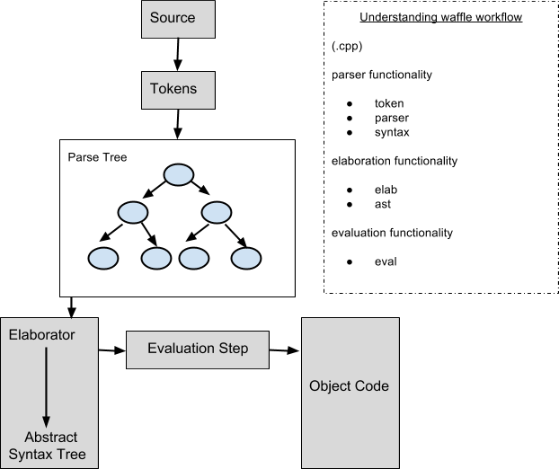
Waffle Workflow

Slide 6
Implementation
Parser
Elaboration
Abstract Syntax Tree
Evaluation

Slide 7
File system commands
Keywords
ls
mkdir
rmdir
mv
cd
Tokens
ls_tok
mkdir_tok
rmdir_tok
mv_tok
cd_tok

Slide 8
Parser
Purpose: To parse the script commands without execution in order to check for syntax errors.
ls-expr ::= 'ls' string-expr
mkdir-expr ::= 'mkdir' string-expr
rmdir-expr ::= 'rmdir' string-expr
cd-expr ::= 'cd' string-expr
mv-expr ::= 'mv' string-expr string-expr

Slide 9
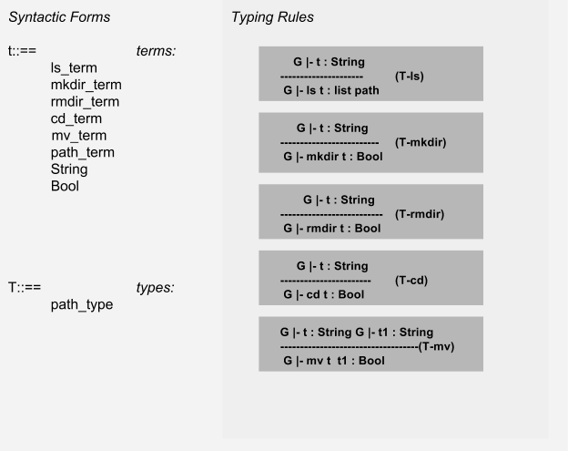
Elaboration
Goal: Checking the well-formedness of programs.
In this step we are elaborating syntax tree (example: Ls_tree * t) returned from parser using below typing rules.

Slide 10
Abstract Syntax Tree
Purpose: The internal representation of our compiler is specified by an abstract syntax tree (ast file) in terms of statements, expressions or identifiers.
An AST is usually the result of the syntax analysis phase of a compiler. This will allow us to verify the correctness of our program

Slide 11
Terms:
init_node(ls_term, "ls");
init_node(mkdir_term, "mkdir");
init_node(rmdir_term, "rmdir");
init_node(cd_term, "cd");
init_node(mv_term, "mv");
Init_node(path_term, “path”);
Types:
init_node(path_type, "path-type");

Slide 12
Evaluation
We have evaluated ls,mkdir,rmdir,cd,mv terms using Boost Filesystem.
This library simplifies working with files and directories by providing a class named boost::filesystem::path (central class) that allows to process paths
#Finds and loads settings from an external project.
find_package(Boost 1.55.0 COMPONENTS filesystem system REQUIRED)
include_directories(${Boost_INCLUDE_DIRS})

Slide 13
Evaluation LS
Evaluating ls term
Term* eval_ls(Ls* t)
The path term is stored in boost::filesystem::path variable as string and using the basic operator boost::filesystem::directory_iterator list of files are pushed into Term_seq.
Finally list of paths is returned.

Slide 14
Evaluation mkdir and rmdir
Term* eval_mkdir(Mkdir* t) method.
using the operator boost::filesystem::create_directory, directory is created.
Term* eval_rmdir(Rmdir* t) method.
If the input path is directory then using boost::filesystem::remove_all function directory is deleted.

Slide 15
Evaluation cd and mv
Term* eval_cd(Cd* t) method.
If the input path is directory then using chdir function directory is changed and boost::filesystem::current_path will set current path of working directory.
Term* eval_mv(Mv* t) method.
The old and new path terms are stored in variables of type boost::filesystem::path and using the basic operator boost::filesystem::rename(p,p1) the directory is moved to new path.

Slide 16
Demonstration

Slide 17
Conclusion
We run ls/mkdir/rmdir/cd/mv commands we get expected results.
Successfully implemented basic shell commands to operate on folders.

Slide 18
Future Work
Can be applied to implement few other shell scripting commands.
Improve the functionality of these commands by adding options.

Slide 19
THANK you

